Slide 1
CS 211 Computer Architecture Lecture 11: RISC-V Architecture - Introduction – Part 1
Ravi Mittal
ravi.mittal@iitgoa.ac.in
Indian Institute of Technology, Goa

Slide 2
Today’s Thought
Definition of insanity: Doing the same thing again and again and expecting different results

Slide 3
Acknowledgements
Class Presentation, CS61C, Introduction to Assembly Language and RISC-V Instruction Set Architecture, University of Berkeley, Prof Krste Asanović & Randy H. Katz. http://inst.eecs.Berkeley.edu/~cs61c
Class Presentation, CS61C, Introduction to Machine Language, University of Berkeley, Branden Ghena, http://inst.eecs.Berkeley.edu/~cs61c, 2019
Computer Organization and Design, The Hardware Software Interface, RISC-V edition, Patterson and Hennessey
Digital Design and Computer Architecture: RISC-V Edition, Harris & Harris Elsevier – Presentation.

Slide 4
In today’s class we will study
RISC-V Basics
RISC Architecture
Registers
RISC-V Instructions

Slide 5
RISC-V Basics

Slide 6
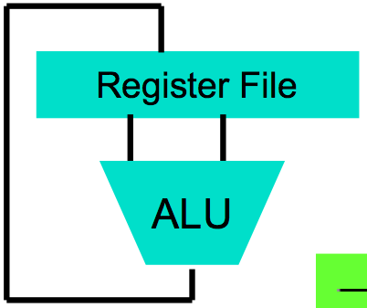
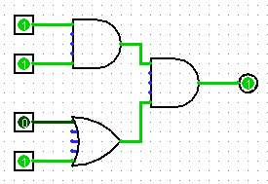
Levels of Representation/Interpretation
High Level Language Program (e.g., C)
temp = v[k];
v[k] = v[k+1];
v[k+1] = temp;
Compiler
Anything can be represented as a number, i.e., data or instructions
Assembly Language Program (e.g., RISC-V)
lw $t0, 0($2)
lw $t1, 4($2)
sw $t1, 0($2)
sw $t0, 4($2)
Assembler
0000 1001 1100 0110 1010 1111 0101 1000
1010 1111 0101 1000 0000 1001 1100 0110
1100 0110 1010 1111 0101 1000 0000 1001
0101 1000 0000 1001 1100 0110 1010 1111
Machine Language Program (RISC-V)
Machine Interpretation
Hardware Architecture Description (e.g., block diagrams)
Architecture Implementation
Logic Circuit Description (Circuit Schematic Diagrams)
Prof Krste Asanović & Randy H. Katz, Univ of California, Berkeley

Slide 7
RISC Philosophy (revision)
Early trend was to add more and more instructions to new CPUs to do elaborate operations
VAX architecture had an instruction to multiply polynomials!
RISC philosophy (Cocke IBM, Patterson UCB, Hennessy Stanford, 1980s)
Reduced Instruction Set Computing
Keep the instruction set small and simple, in order to build fast hardware
Let software do complicated operations by composing simpler ones

Slide 8
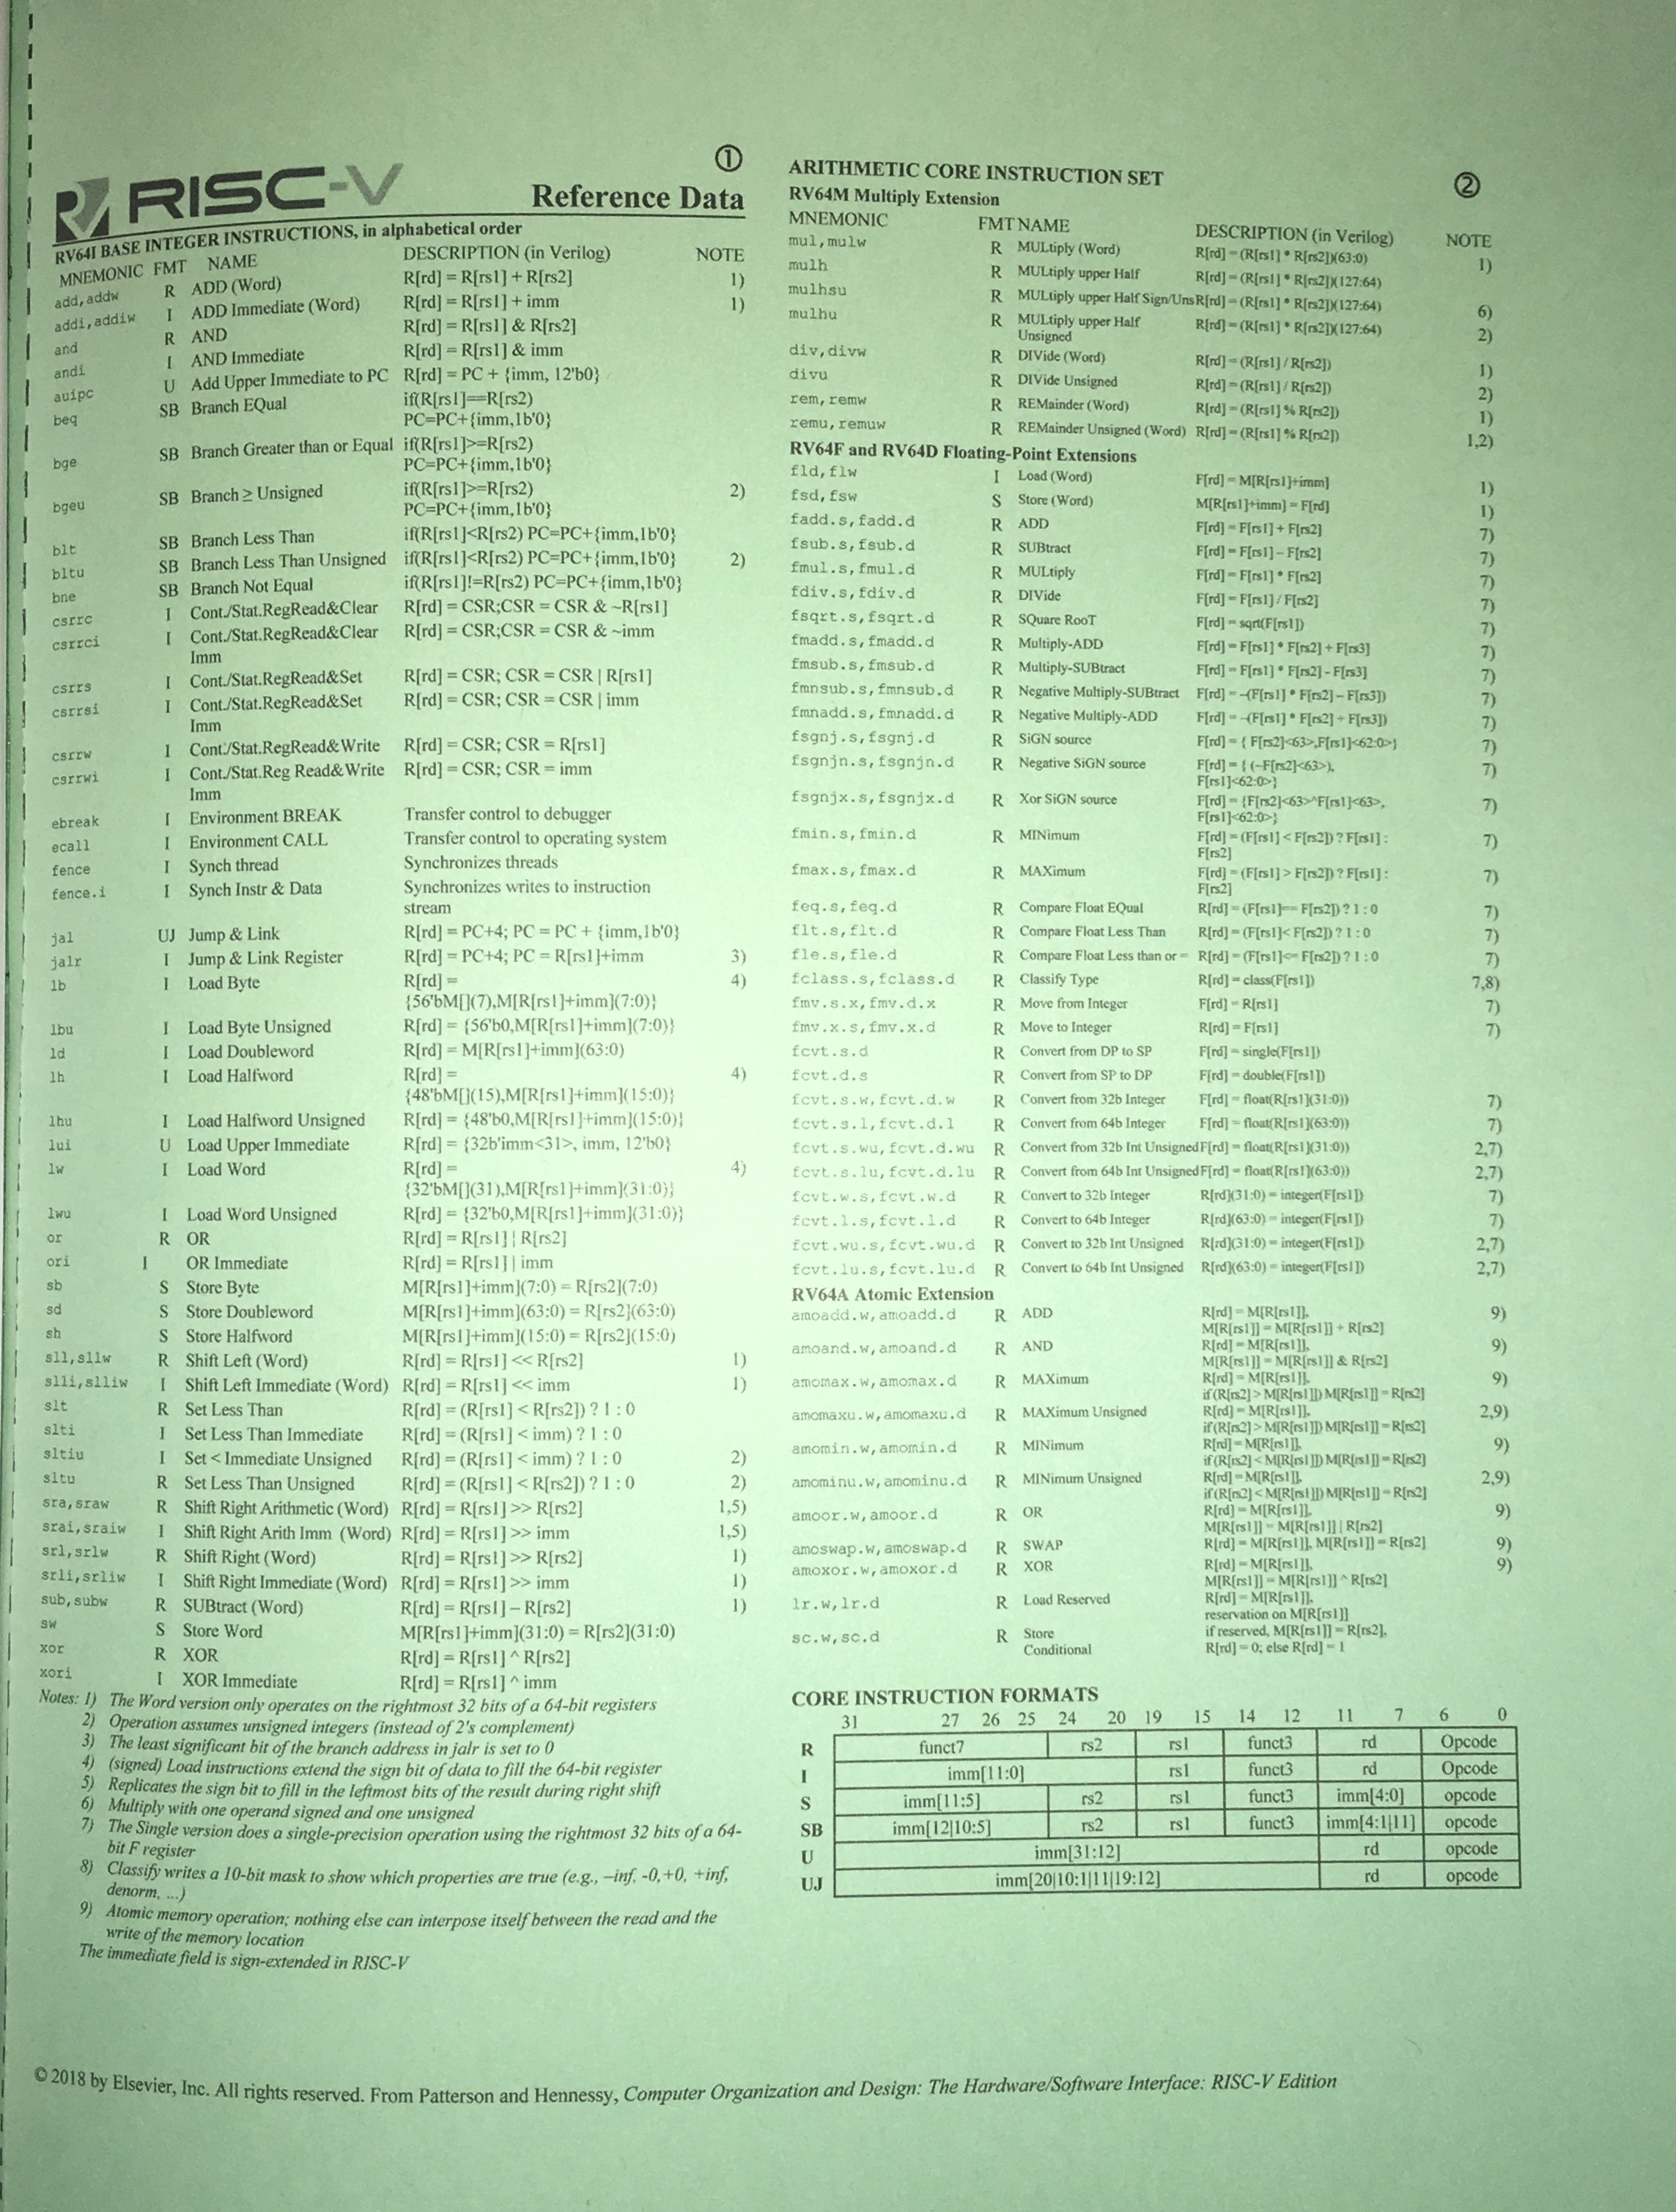
RISC-V Green Card (in textbook: P&H)

Slide 9
RISC Architecture
CS 305: Computer Architecture

Slide 10
What is RISC-V?
Fifth generation of RISC design from UC Berkeley
New open-source, license-free ISA specification
Supported by growing shared software ecosystem
Appropriate for all levels of computing system, from microcontrollers to supercomputers
32-bit, 64-bit, and 128-bit variants (we’re using 32-bit in class, textbook uses 64-bit)
Why RISC-V instead of Intel 80x86?
RISC-V is simple, elegant. Don’t want to get bogged down in gritty details.
RISC-V has exponential adoption
Prof Krste Asanović & Randy H. Katz, Univ of California, Berkeley

Slide 11

































Foundation Members (60+)
Platinum:
Gold, Silver, Auditors:
Rumble
Development
Prof Krste Asanović & Randy H. Katz, Univ of California, Berkeley

Slide 12
Registers

Slide 13
C, Java Variables vs. Registers
In C (and most HLLs):
Variables declared and given a type
Example: int fahr, celsius; char a, b, c, d, e;
Each variable can ONLY represent a value of the type it was declared (e.g., cannot mix and match int and char variables)
In Assembly Language:
Unlike C, assembly doesn’t have variables as you know them
Instead, assembly uses registers to store values
Registers have no type
Operation determines how register contents are interpreted
Prof Krste Asanović & Randy H. Katz, Univ of California, Berkeley

Slide 14
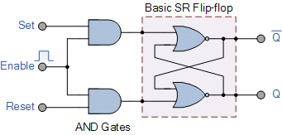
C, Java Variables vs Registers
Assembly is more primitive, closer what simple hardware can directly support
Registers are:
Small memories of a fixed size (32-bit in our system)
Can be read or written
Limited in number (32 registers on our system)
Very fast and low power to access
Benefit: Since registers are directly in hardware, they are very fast (faster than 0.25ns)
Recall light is 3x10⁸m/s = 0.3m/ns = 30cm/ns = 10cm/0.3ns!!!... where 0.3ns is the clock period of a 3.33GHz computer
Prof Krste Asanović & Randy H. Katz, Univ of California, Berkeley

Slide 15
Registers vs. Memory
What if more variables than registers?
Keep most frequently used in registers and move the rest to memory (called spilling to memory)
Why not all variables in memory?
Smaller is faster: registers 100-500 times faster
Memory Hierarchy
Registers: 32 registers * 32 bits = 128 Bytes
RAM: 4-32 GB
SSD: 100-1000 GB

Slide 16
Aside: Registers are inside the Processor
Processor
Enable?
Read/Write
Memory
Input
Control
Program
Datapath
Address
PC
Bytes
Registers
Write Data
Arithmetic & Logic Unit
(ALU)
Data
ReadData
Output
Processor-Memory Interface
I/O-Memory Interfaces
Prof Krste Asanović & Randy H. Katz, Univ of California, Berkeley
Notes:
focus memory

Slide 17
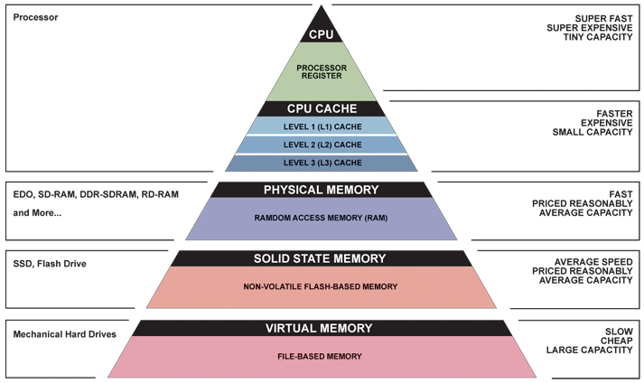
Great Idea #3: Principle of Locality / Memory Hierarchy
Registers
Memory

Slide 18
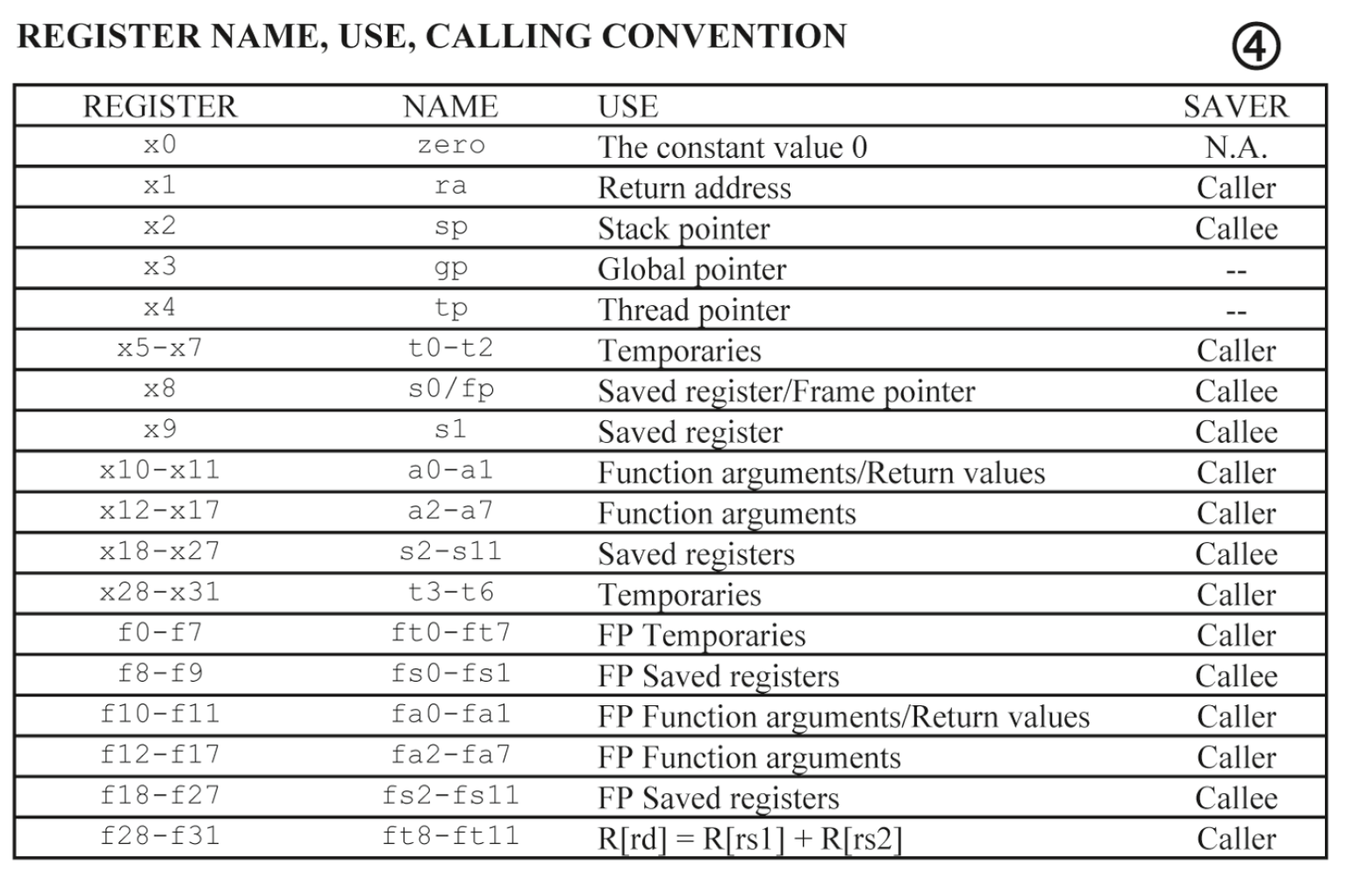
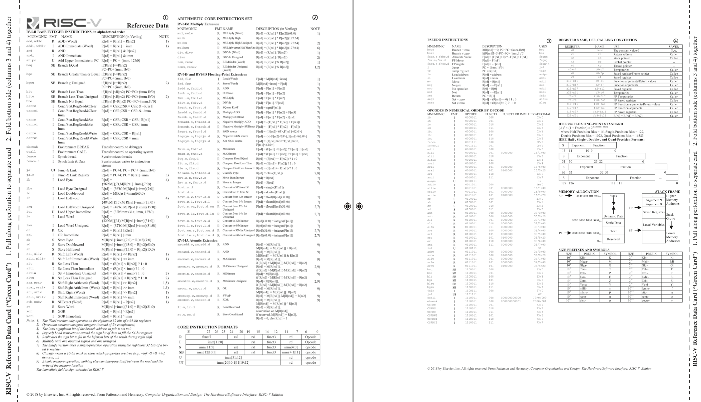
RISC-V -- How Many Registers?
Tradeoff between speed and availability
more registers → can house more variables simultaneously
all registers are slower.
RISC-V has 32 registers (x0-x31)
Each register is 32 bits wide and holds a word
Notes:
word = group of 32 bits (like how byte = group of 8 bits)
For the sake of comparison, ARM uses 16 registers.
How many bytes is a word?
what if we need more variables than that?!

Slide 19
Number of RISC-V Registers
Since registers are in hardware, there are a limited number of them
Solution: RISC-V code must be carefully written to efficiently use registers
Why 32 registers?
Smaller is faster, but too small is bad. Also, it is hard to create too many registers – at the cost of other components
P&H textbook uses the 64-bit variant RV64
Prof Krste Asanović & Randy H. Katz, Univ of California, Berkeley

Slide 20
Registers have no type (C concept); the operation being performed determines how register contents are treated

Slide 21
RISC-V Register Set
Name | Register Number | Usage
zero | x0 | Constant value 0
ra | x1 | Return address
sp | x2 | Stack pointer
gp | x3 | Global pointer
tp | x4 | Thread pointer
t0-2 | x5-7 | Temporaries
s0/fp | x8 | Saved register / Frame pointer
s1 | x9 | Saved register
a0-1 | x10-11 | Function arguments / return values
a2-7 | x12-17 | Function arguments
s2-11 | x18-27 | Saved registers
t3-6 | x28-31 | Temporaries
Symbolic name can also be used for programming instead of register number.
Assembler converts these to corresponding register numbers.

Slide 22
RISC-V Registers
Register denoted by ‘x’ can be referenced by number (x0-x31) or name:
Registers that hold programmer variables:
s0-s1 ⬌ x8-x9
s2-s11 ⬌ x18-x27
Registers that hold temporary variables:
t0-t2 ⬌ x5-x7
t3-t6 ⬌ x28-x31
Other registers have special purposes we’ll discuss later
Ref: Branden Ghena, Univ of California, Berkeley

Slide 23
A Special Register
What’s the most important number?
Disclaimer: in programming

Slide 24
The Zero Register
Zero appears so often in code and is so useful that it has its own register!
Register zero (x0 or zero) always has the value 0 and cannot be changed!
any instruction writing to x0 has no effect
Ref: Branden Ghena, Univ of California, Berkeley

Slide 25
Summary - Registers
In high-level languages, number of variables limited only by available memory
ISAs have a fixed, small number of registers
Special locations built directly into hardware
Benefit: Registers are EXTREMELY FAST (faster than 1 billionth of a second)
Drawback: Operations can only be performed on these predetermined number of registers
Ref: Branden Ghena, Univ of California, Berkeley

Slide 26
RISC-V Instructions

Slide 27
Example RISC-V Assembly
# Fibonacci Sequence
main: add t0, x0, x0
addi t1, x0, 1
la t3, n
lw t3, 0(t3)
fib: beq t3, x0, finish
add t2, t1, t0
mv t0, t1
mv t1, t2
addi t3, t3, -1
j fib
finish: addi a0, x0, 1
addi a1, t0, 0
ecall # print integer ecall
addi a0, x0, 10
ecall # terminate ecall
Ref: Branden Ghena, Univ of California, Berkeley

Slide 28
Example RISC-V Assembly
# Fibonacci Sequence
main: add t0, x0, x0
addi t1, x0, 1
la t3, n
lw t3, 0(t3)
fib: beq t3, x0, finish
add t2, t1, t0
mv t0, t1
mv t1, t2
addi t3, t3, -1
j fib
finish: addi a0, x0, 1
addi a1, t0, 0
ecall # print integer ecall
addi a0, x0, 10
ecall # terminate ecall
Various assembly instructions
Ref: Branden Ghena, Univ of California, Berkeley

Slide 29
Example RISC-V Assembly
# Fibonacci Sequence
main: add t0, x0, x0
addi t1, x0, 1
la t3, n
lw t3, 0(t3)
fib: beq t3, x0, finish
add t2, t1, t0
mv t0, t1
mv t1, t2
addi t3, t3, -1
j fib
finish: addi a0, x0, 1
addi a1, t0, 0
ecall # print integer ecall
addi a0, x0, 10
ecall # terminate ecall
Comments use the # symbol
Ref: Branden Ghena, Univ of California, Berkeley

Slide 30
Example RISC-V Assembly
# Fibonacci Sequence
main: add t0, x0, x0
addi t1, x0, 1
la t3, n
lw t3, 0(t3)
fib: beq t3, x0, finish
add t2, t1, t0
mv t0, t1
mv t1, t2
addi t3, t3, -1
j fib
finish: addi a0, x0, 1
addi a1, t0, 0
ecall # print integer ecall
addi a0, x0, 10
ecall # terminate ecall
Labels are arbitrary names that mark a section of code
We’ll get back to these later
Ref: Branden Ghena, Univ of California, Berkeley

Slide 31
Example RISC-V Assembly
# Fibonacci Sequence
main: add t0, x0, x0
addi t1, x0, 1
la t3, n
lw t3, 0(t3)
fib: beq t3, x0, finish
add t2, t1, t0
mv t0, t1
mv t1, t2
addi t3, t3, -1
j fib
finish: addi a0, x0, 1
addi a1, t0, 0
ecall # print integer ecall
addi a0, x0, 10
ecall # terminate ecall
op dst, src1, src2
What does this instruction do?
Ref: Branden Ghena, Univ of California, Berkeley

Slide 32
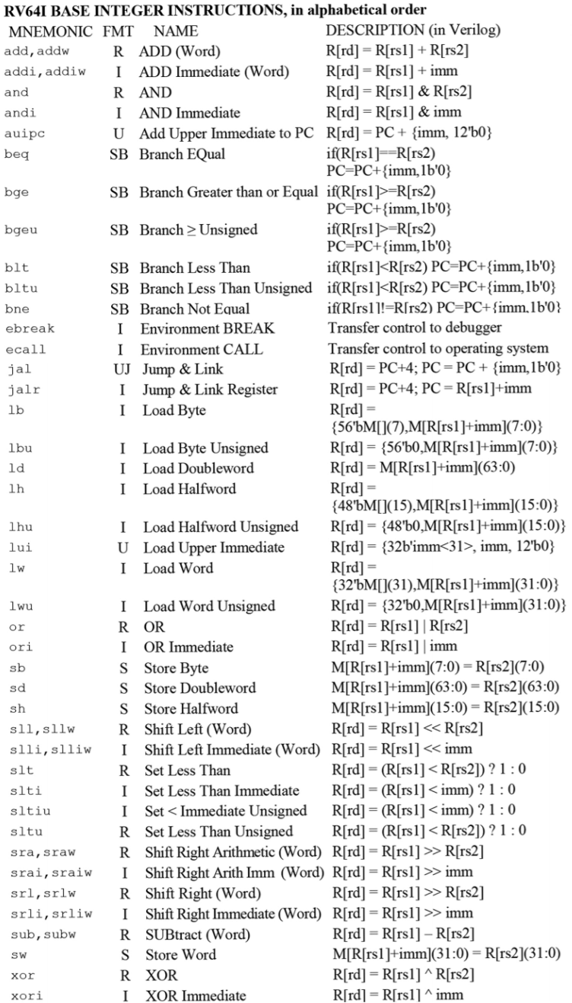
There are many instructions
We’ll be covering the types of instructions in class. You should look through what specific commands exist on the green card.
Ref: Branden Ghena, Univ of California, Berkeley

Slide 33
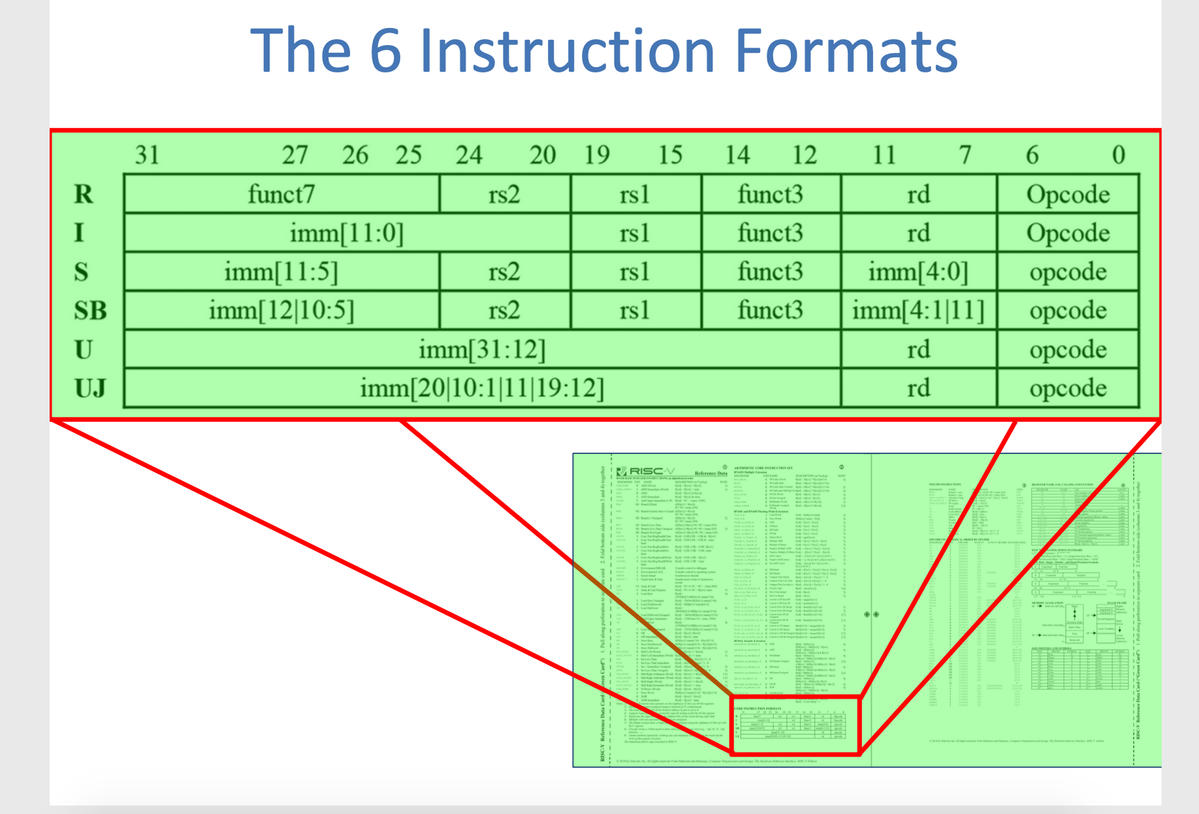
RISC-V Logical Instructions
Ref: Steven Ho, CS61C Su18 - Lecture 7 Univ of California, Berkeley
Notes:
CS61C Su18 - Lecture 7

Slide 34
RISC-V Instruction Formats
R-Format: instructions using 3 register inputs
add, xor, mul - arithmetic/logical ops
I-Format: instructions with immediates, loads
addi, lw, jalr, slli
S-Format: store instructions: sw, sb
SB-Format: branch instructions: beq, bge
U-Format: instructions with upper immediates
lui, auipc —upper immediate is 20-bits
UJ-Format: jump instructions: jal

Slide 35
Lecture Summary
RISC-V: Developed by Krste Asanovic, David Patterson and their colleagues at UC Berkeley in 2010
First open-source computer architecture
Minimal, Uniform, and simple instructions
RISC-V ISA requires software to break complex operations into a string of simple instructions, but enables faster, simple hardware
Hardware registers provide a few very fast variables for instructions to operate on

